Slide 1



Japan’s Incentive Regulations
23/September/2026

Slide 2
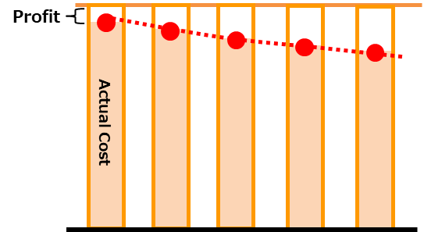
Japan’s revenue cap system
Revenue Cap scheme
The average monthly regulated electricity bill is ¥13,506 (€74.28).
Wheeling service charges account for around 30% of the total regulated electricity bill.
Revenues Cap
2023
2024
2025
2026
2027
If actual costs fall below the revenue cap, the resulting cost savings may be retained as profit by the transmission and distribution operator.
The revenue cap system incentivizes efficient operation and investment, ultimately helping to reduce network charges for consumers.
Retail | \7,830 | € 43.07
Wheeling service | \4,084 | € 22.46
Renewable energy | \1,392 | € 7.66
Total | \13,506 | € 74.28
Converted at €0.0055 per JPY.

Slide 3
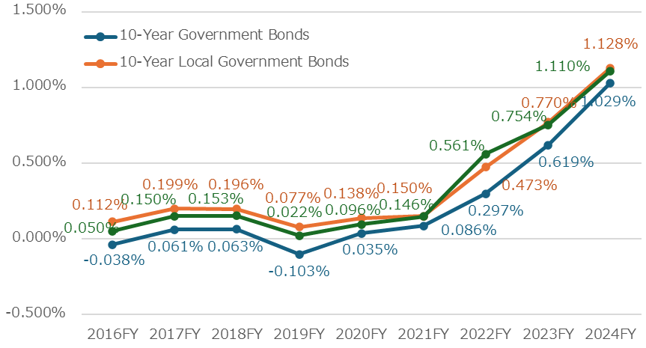
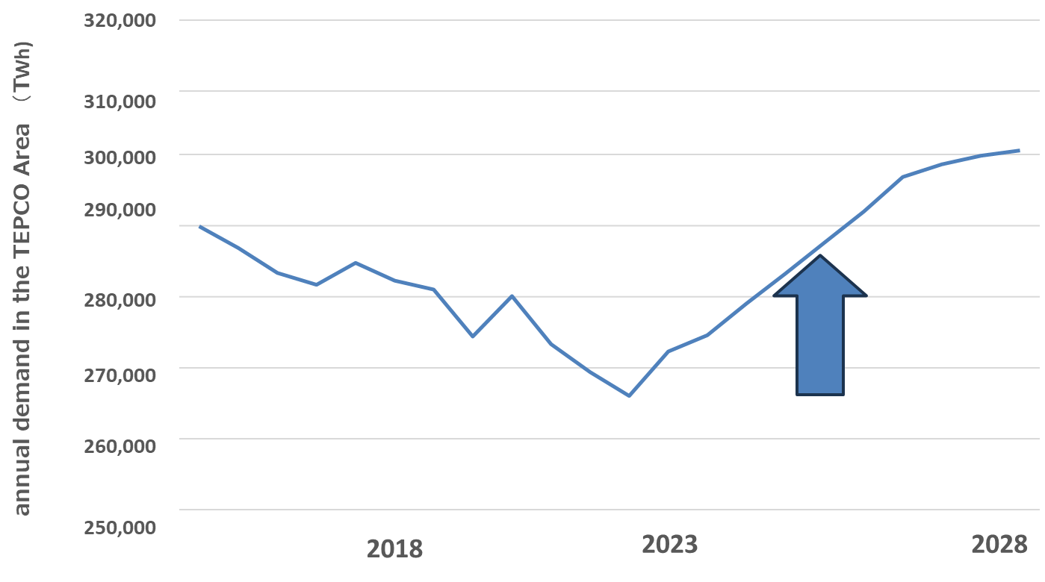
Why Are Reforms Needed for the Second
Regulatory Period?
Challenges
Key Issues for the Second Regulatory Period
Rising interest rates
Inflation and labor costs
Review of the Cost of Capital
Treatment of Inflation and Interest Rate Changes
Framework for Next-Generation Investment
Incentive and Performance Evaluation Mechanisms
Tariff-Setting Approach
Data center demand
Electricity demand in the Tokyo area is expected to grow, driven by large-scale loads such as AI data centers.
Notes:
事業報酬 → Cost of capital
物価等上昇を考慮した審査
ロスシェア・プロフィットシェア
物価・金利変動の反映方法 → Inflation adjustment
規制期間中一律料金の見直し
目標計画・評価方法
次世代投資費用 → Next-generation investments
統計査定の精緻化

Slide 4
The Long-term Decarbonization Auction
Long-term Decarbonization Auction
Objective: Stimulate investment in low-carbon resources
Supported Capacity Over Time
Approximately 7.3 GW of projects were awarded in the 2025 auction.
Supported capacity is expected to exceed 23 GW at its peak, contributing to long-term resource adequacy.
Year X
Capacity (GW)
Auction
Construction
20-year capacity payments
Fixed cost | Variable cost
Capacity payments based on fixed costs
(Bid price ⇒ Successful bid price)
Income from the energy market and the Non-fossil Certificates trading market,etc.
Approximately 90% of market profits is returned
Note: Revenue under the scheme = awarded capacity payment − revenues to be returned

